Slide 1


From Research
To Researcher
How Collaboration Forms
a Scientific Mind
December 1st, 2024

Slide 2
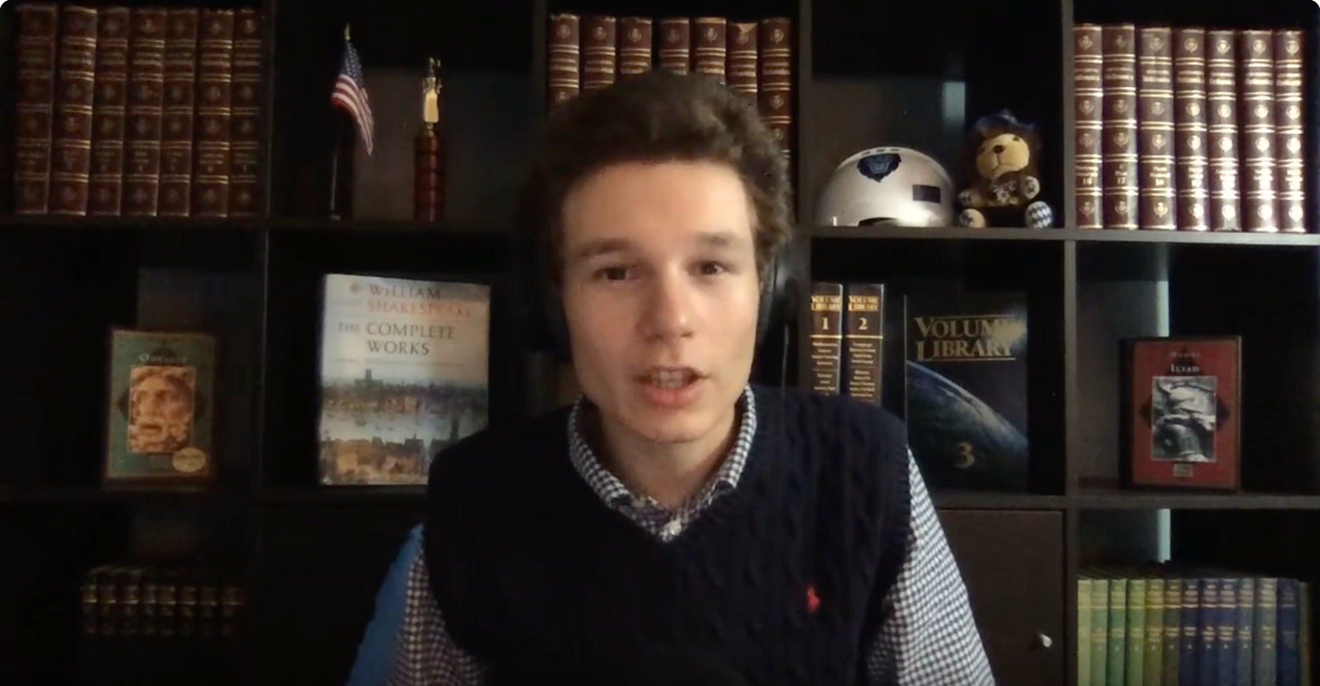
Freshman in College at the ZOOM Activities Fair
09-22-2020

Slide 3
Columbia Space Initiative Had an Idea
Space
Increased resistance
Higher mutation rate
(Altenburg, 2008; Rainey, 2014)
S. aureus
C. albicans
Earth
Increased resistance
Increased virulence
(Todd et al., 2019; Harriott & Noverr, 2009)
Space
Hypothesis:
More Powerful Bacteria:
Greater resistance and mutation than ground and monomicrobial controls
Dual-Species Biofilm

Slide 4
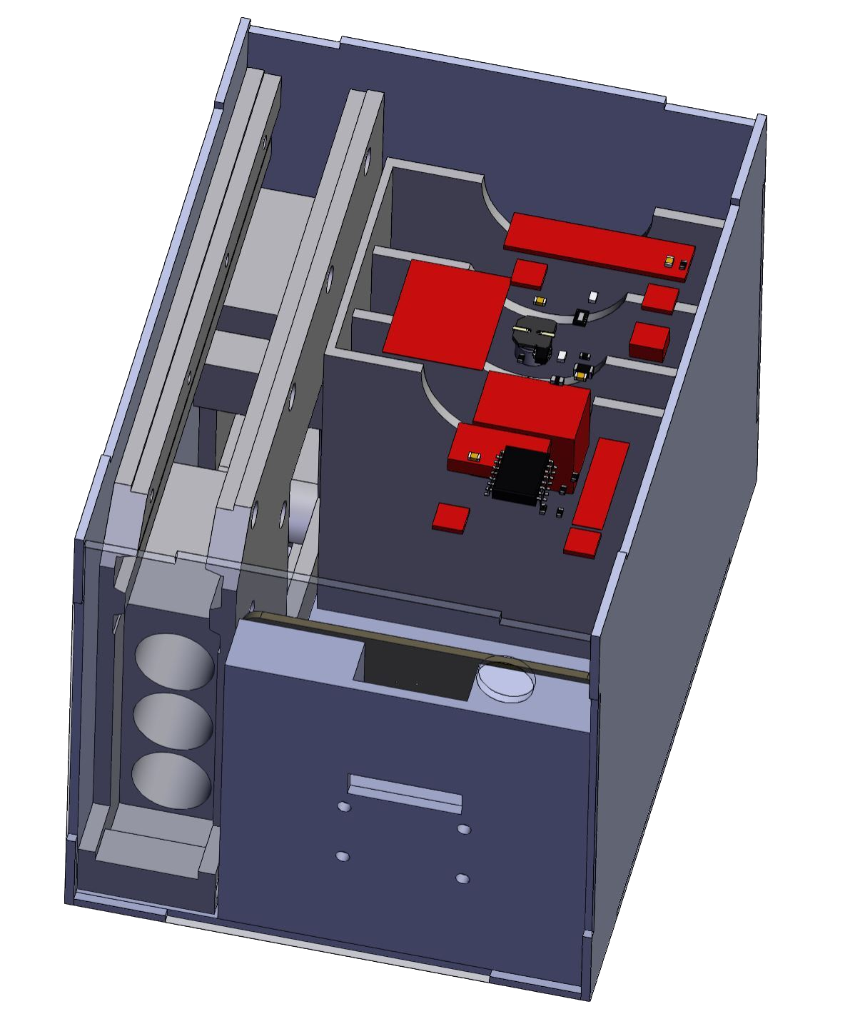
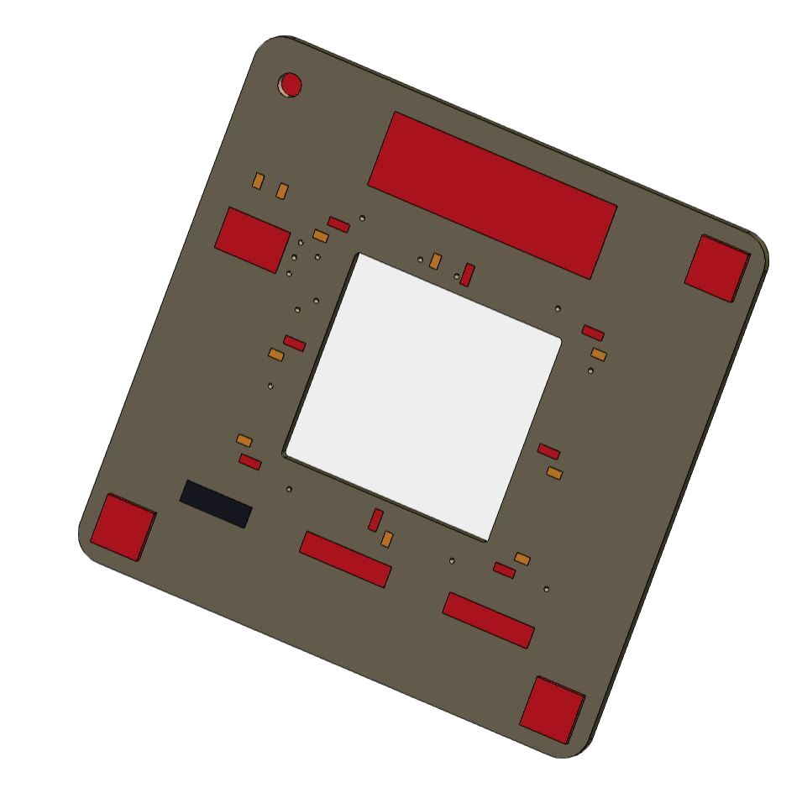
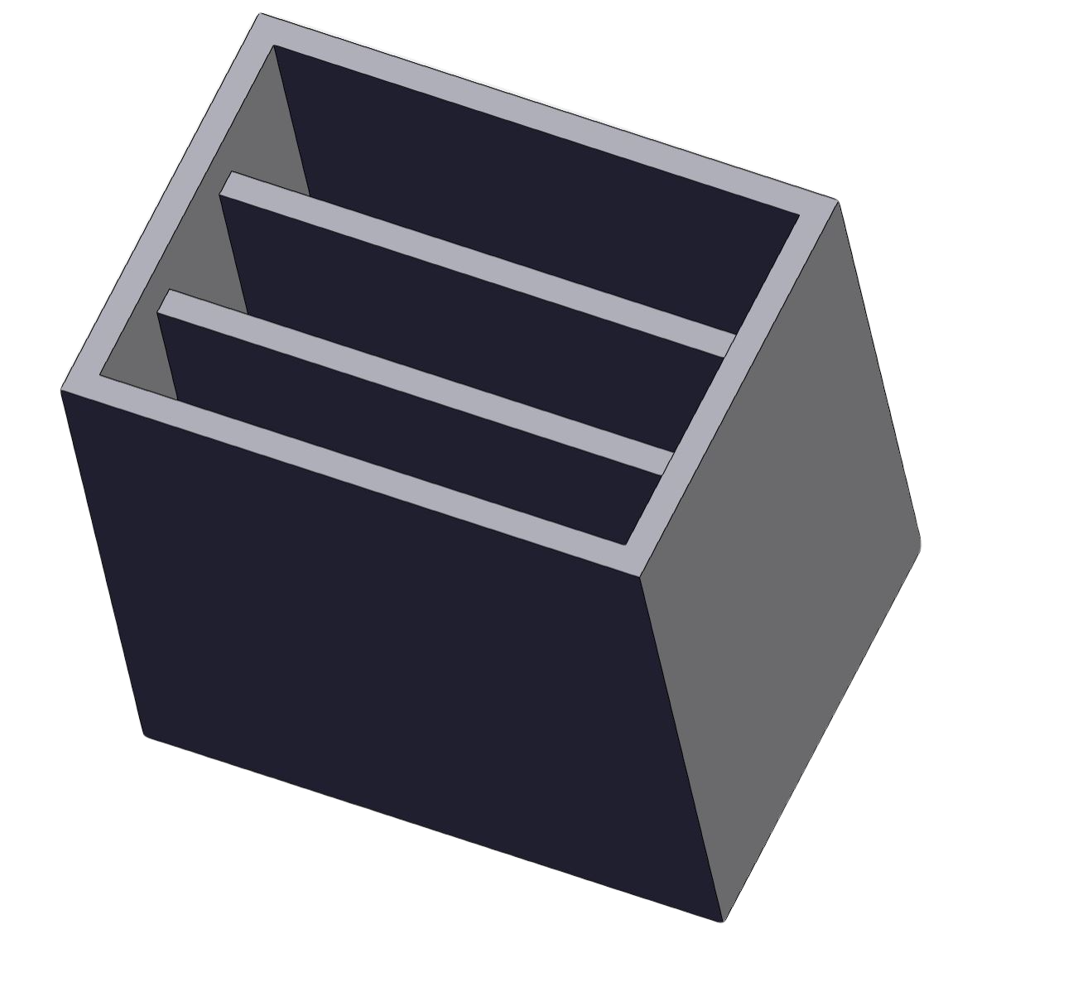
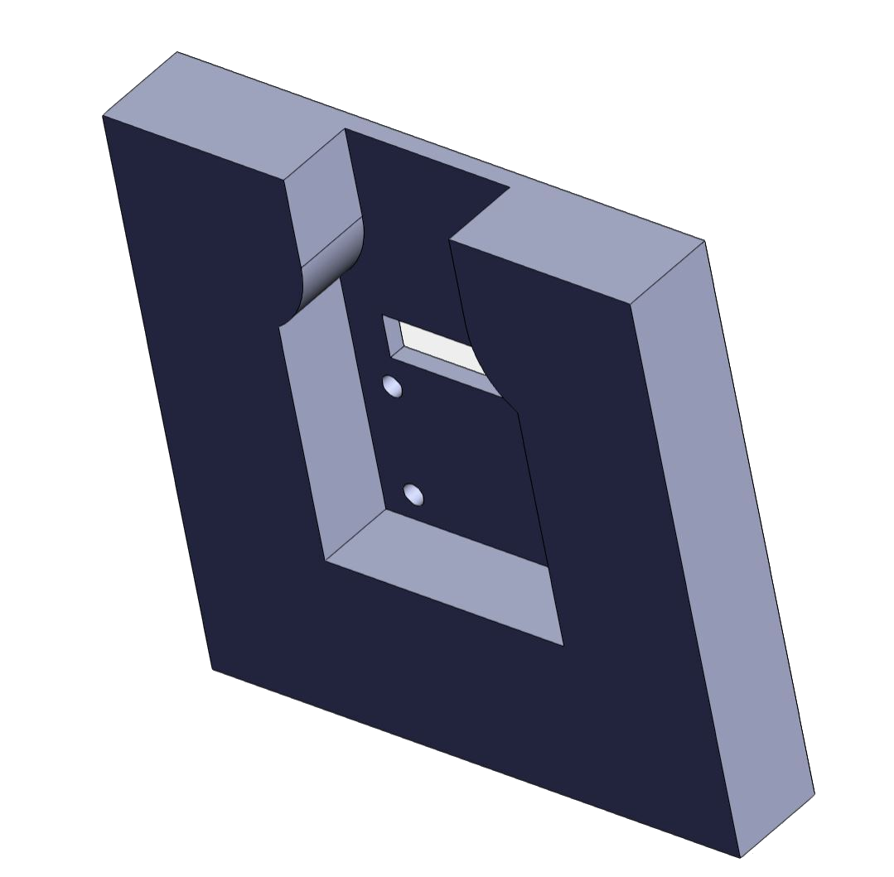
Columbia Space Initiative would Engineer the Payload
Electronics
PCBs, Sensors, Raspberry Pi
Attached to the top face of the casing
Petri dishes and holder
Petri dish holder for antibiotic resistance dishes
Top open dish for imaging
Camera and camera mount
Camera attached to casing through camera mount
Keeps camera stable for imaging

Slide 5

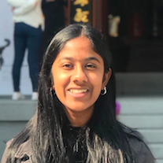


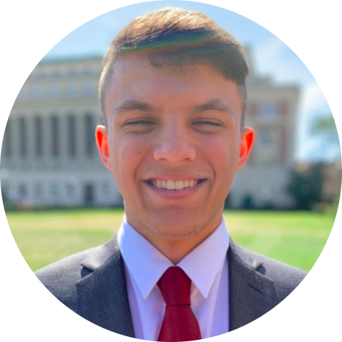

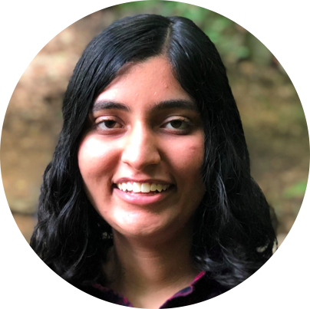

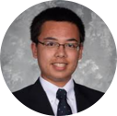
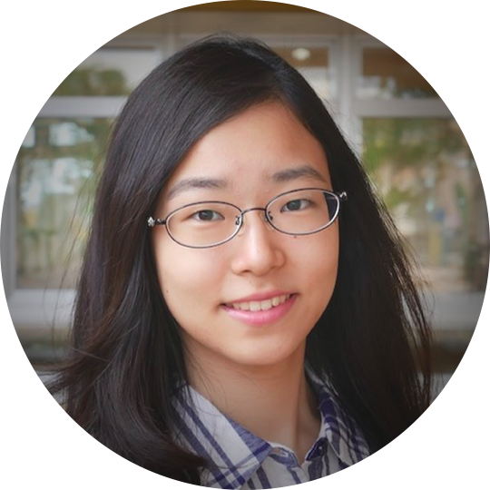
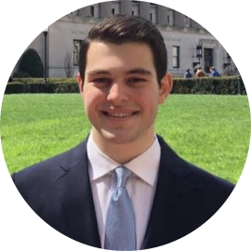
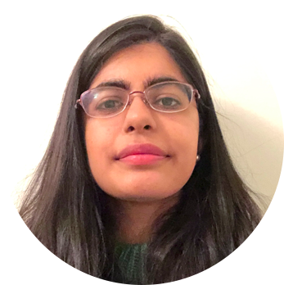
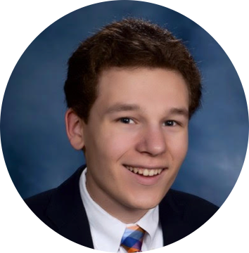


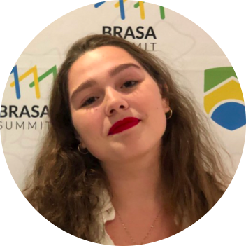
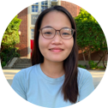
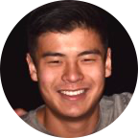
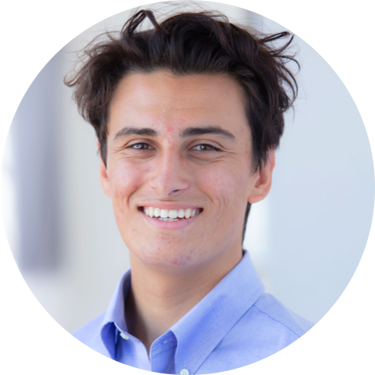
20 students 10 majors 5 faculty collaborators
OUR TEAM

Slide 6

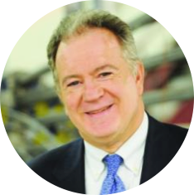
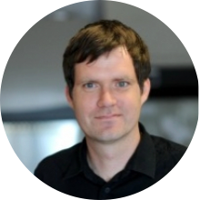
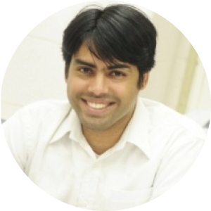

20 students 10 majors 5 faculty collaborators
Dr. Mike Massimino
Faculty Advisor
Former NASA Astronaut
Dr. Raimondo Betti
Structural Systems Advisor
Civil Engineering
Dr. Lars Dietrich
Experimental Advisor
Biological Sciences
Dr. Arvind Narayanaswamy
Thermal Control Systems Advisor
Mechanical Engineering
Dr. David Vallancourt
Electrical Systems Advisor
Electrical Engineering
OUR TEAM

Slide 7
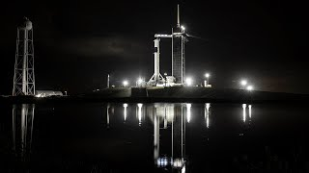

Slide 8
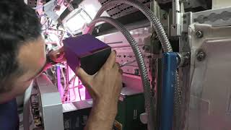

Slide 9
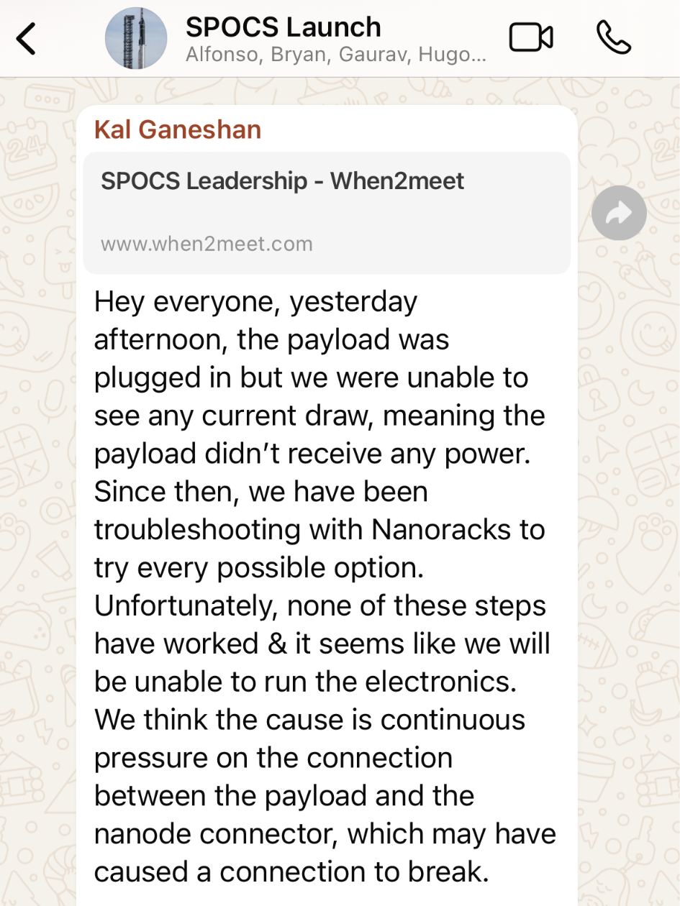
TLDR:
The Electronics Broke

Slide 11
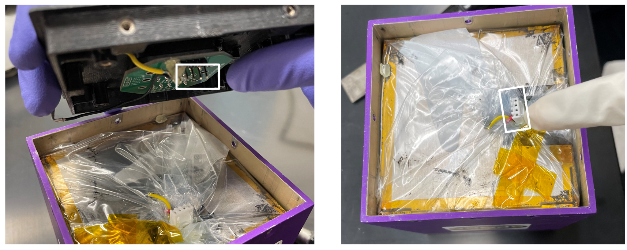

Slide 12
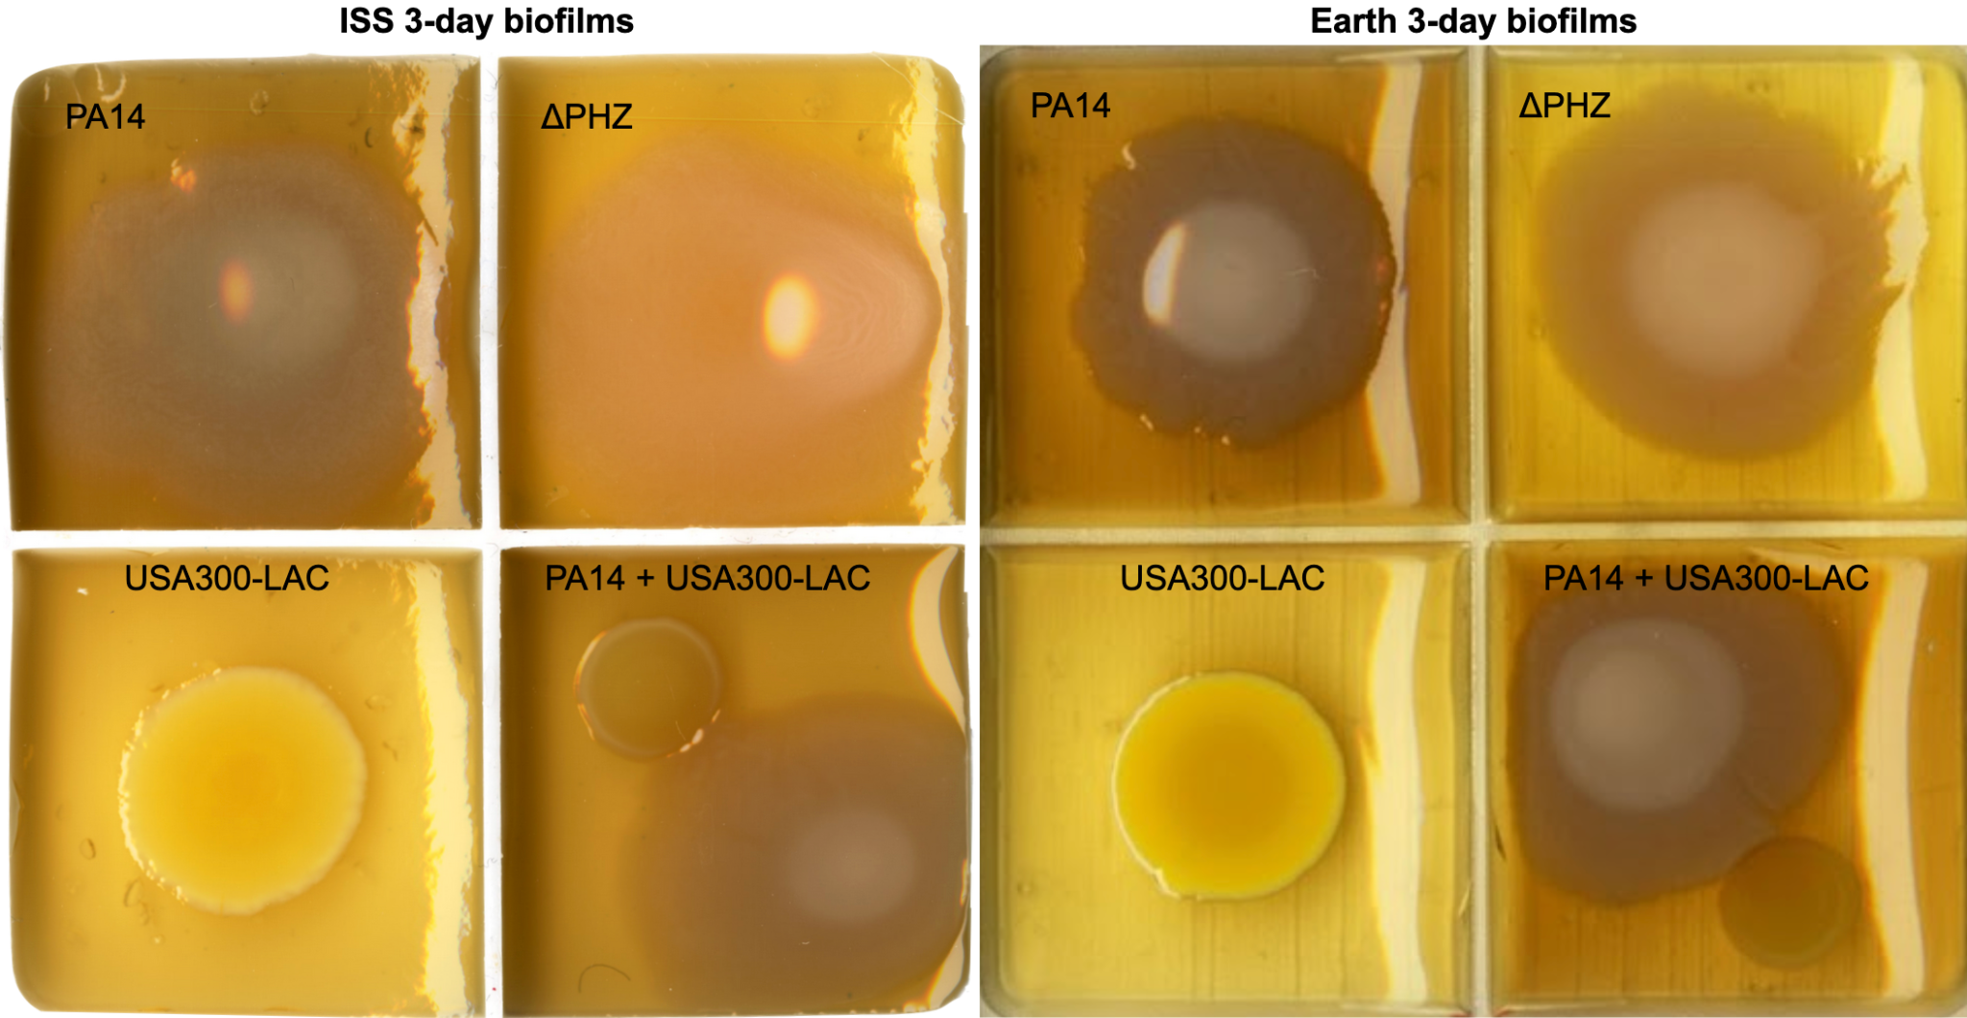

Slide 13
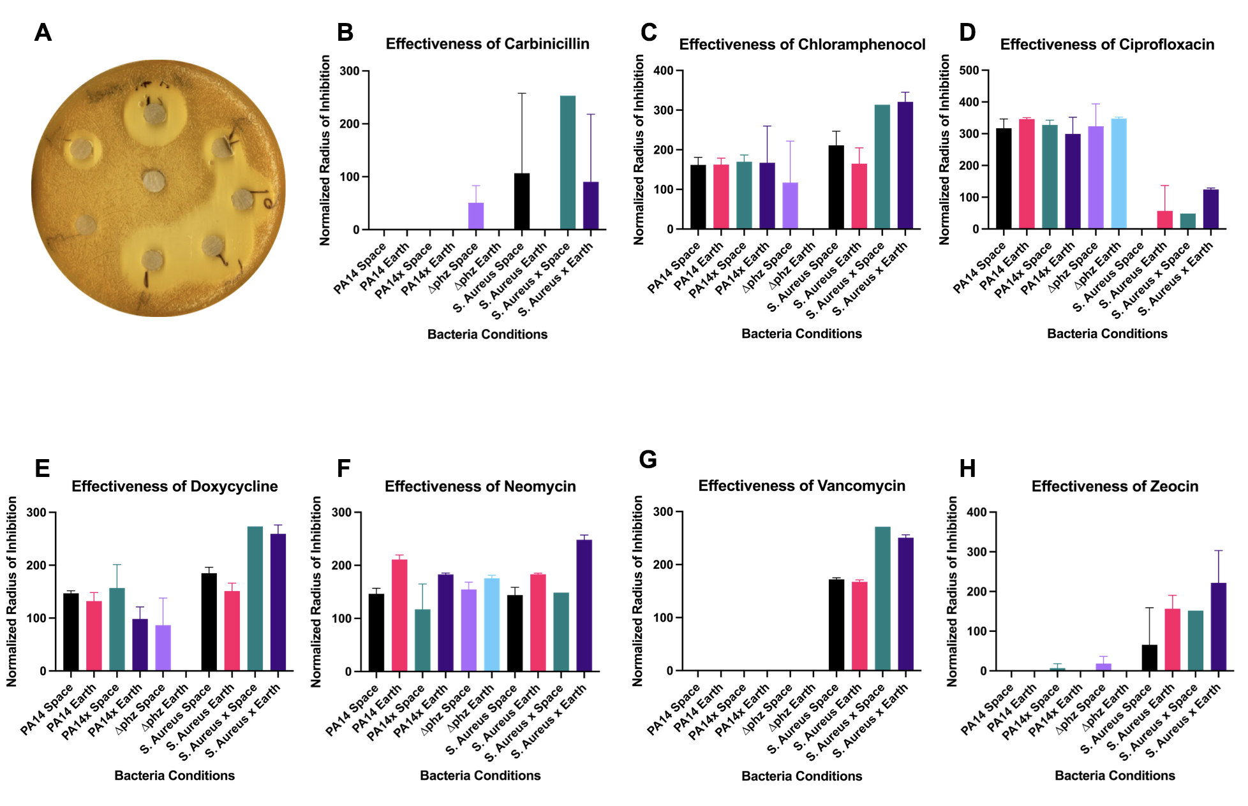

Slide 14
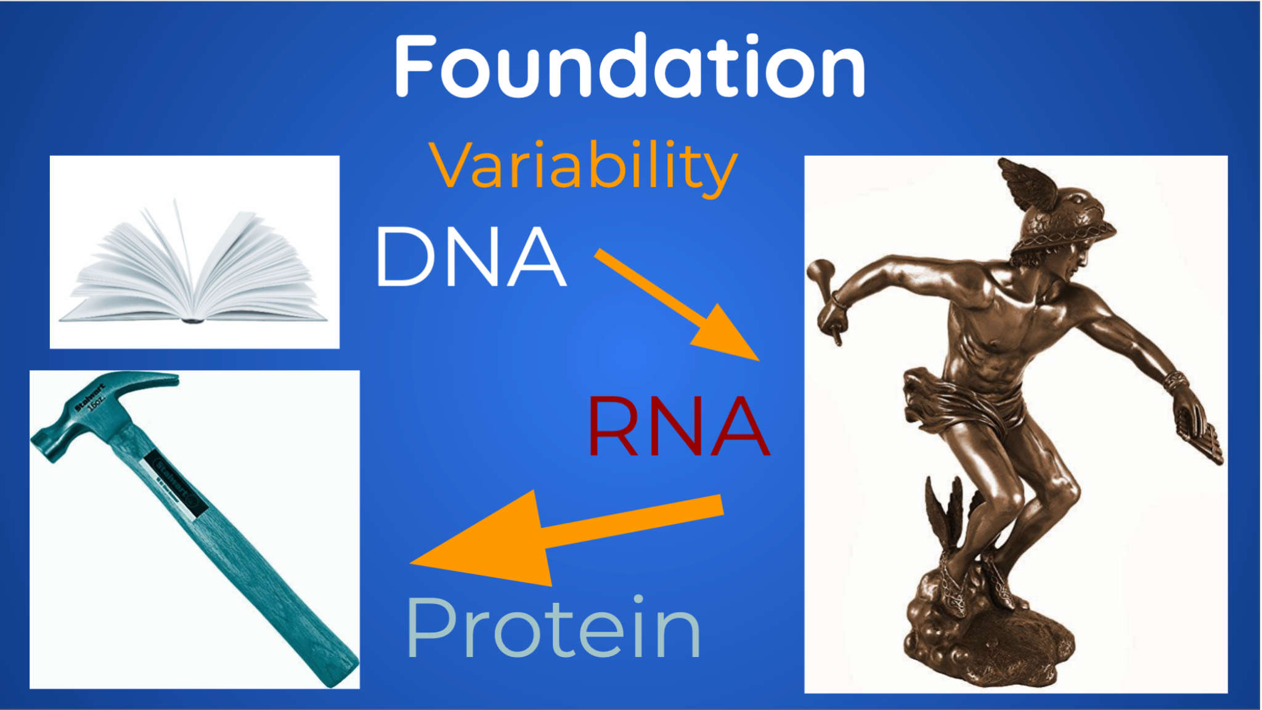

Slide 15


Slide 16
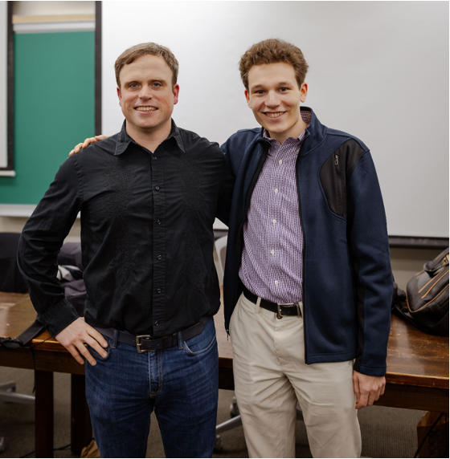
Christopher E. Mason

Slide 17

Contributing to the Largest Repository
of Spaceflight Biology Data Ever

Slide 18
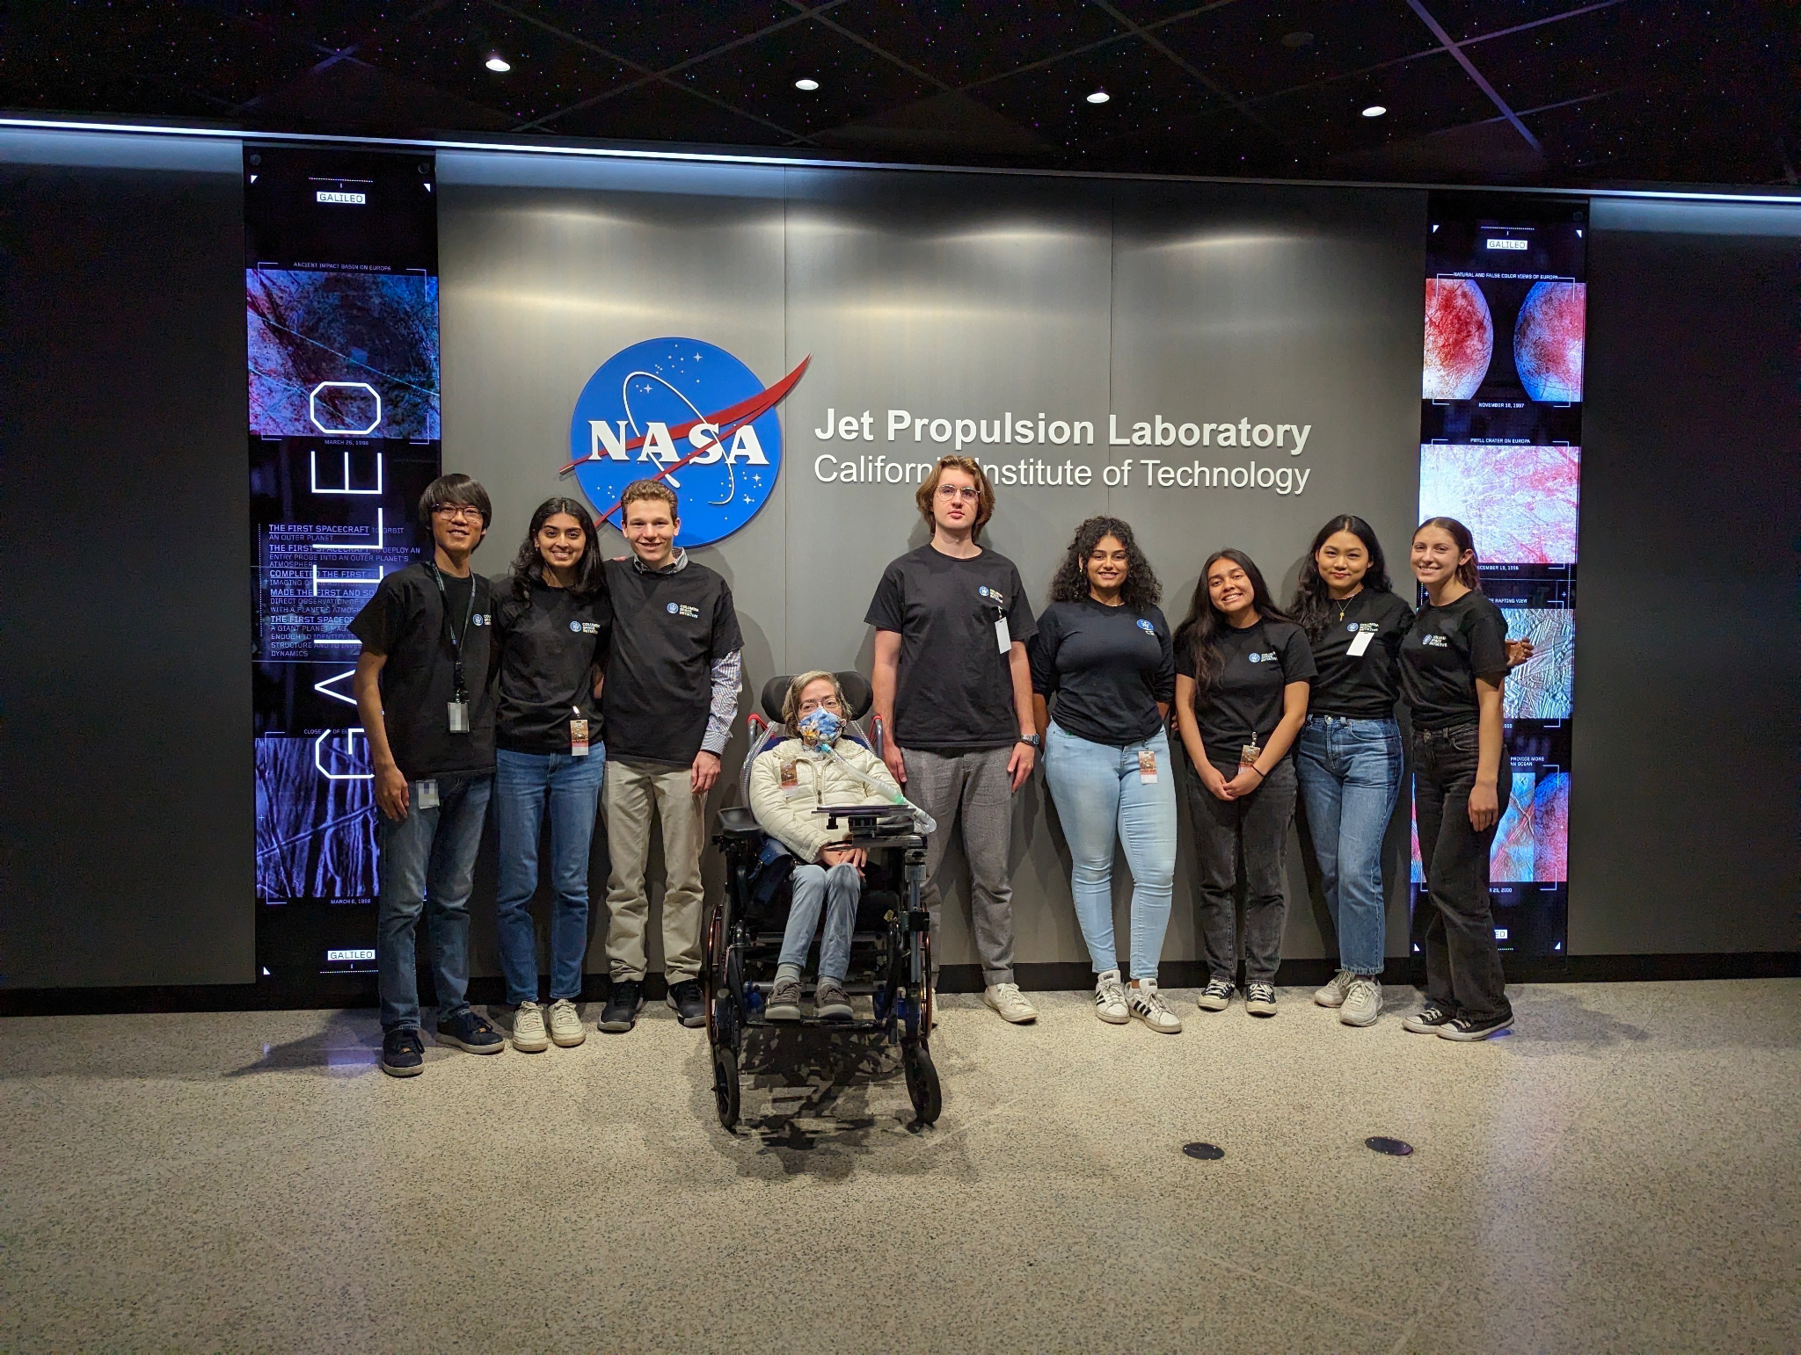
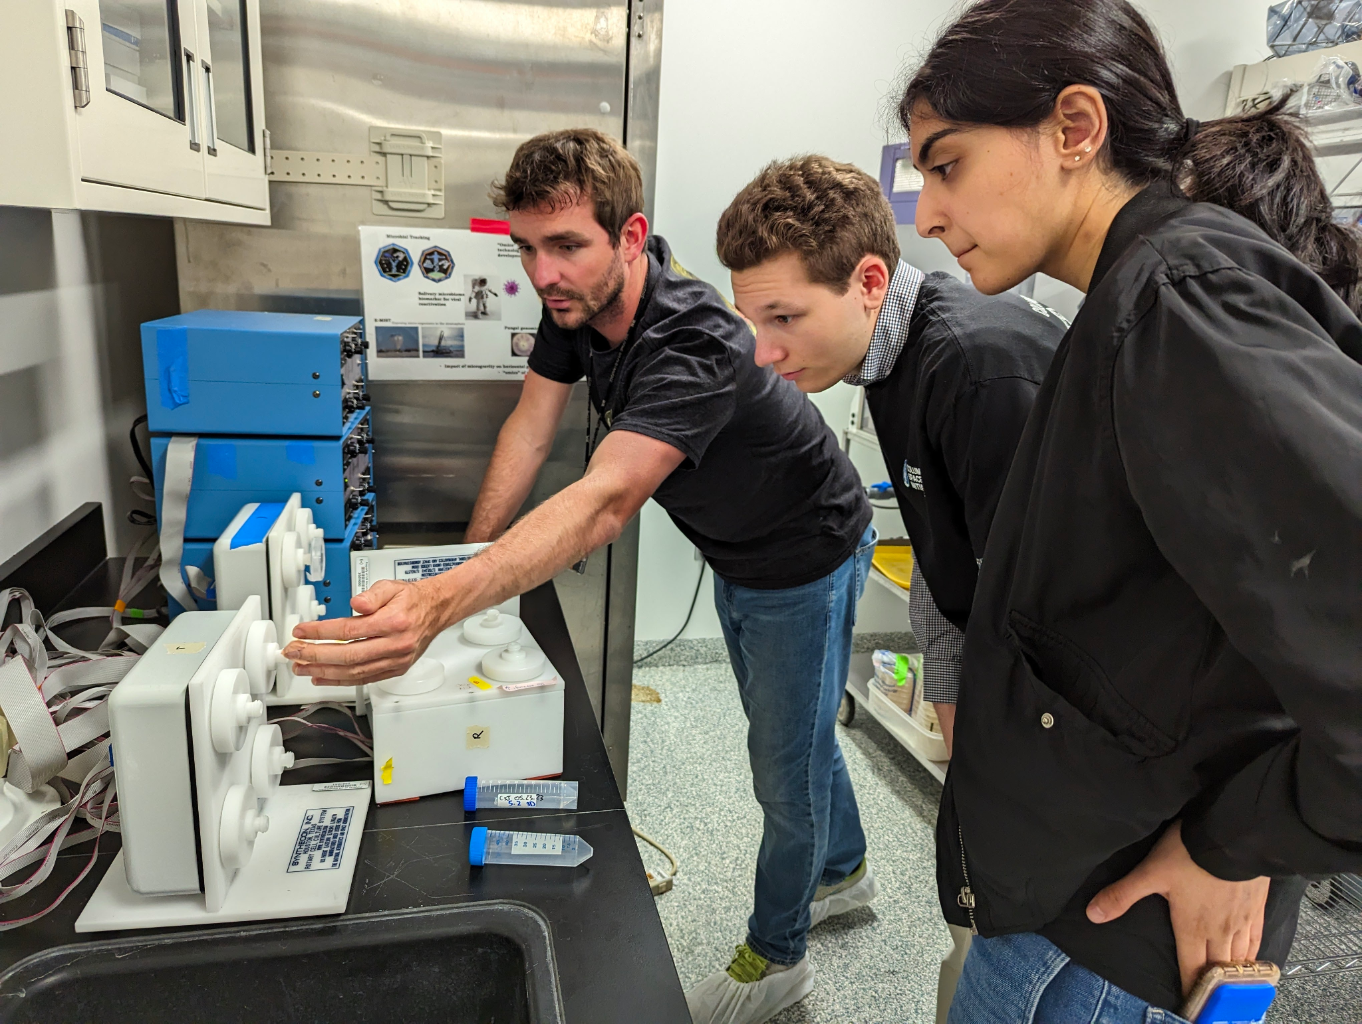
SUMMER @ CSI:
MICROBIO @ NASA’S JET PROPULSION LAB
Notes:
Microbio → Jake → segue to alumni connections

Slide 19
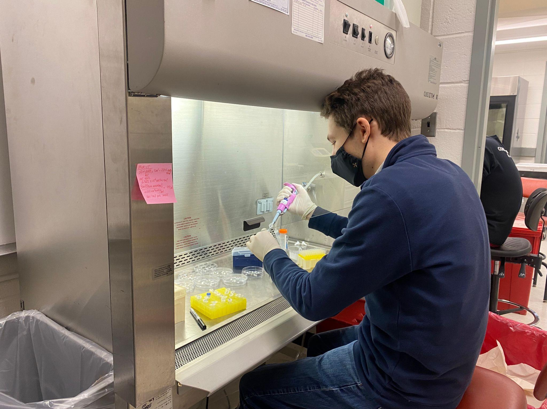
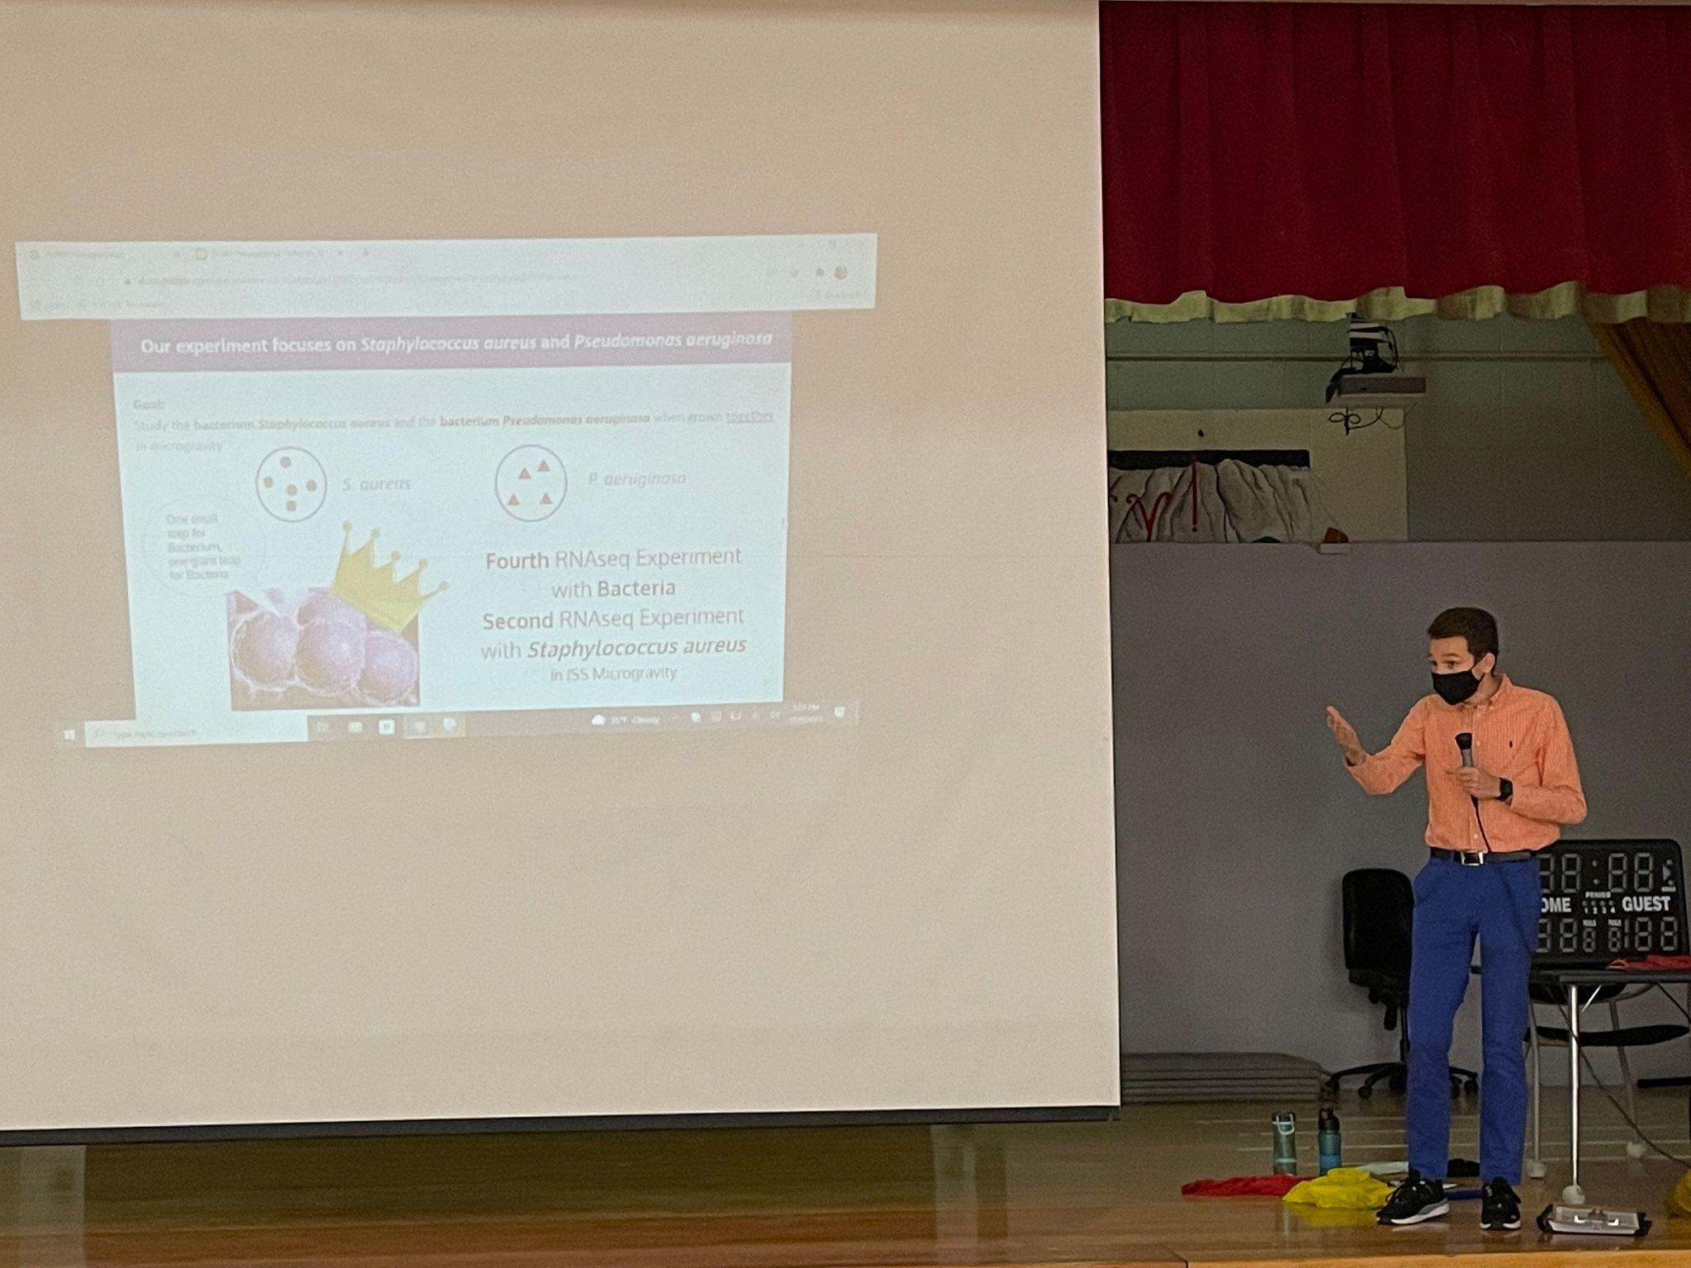
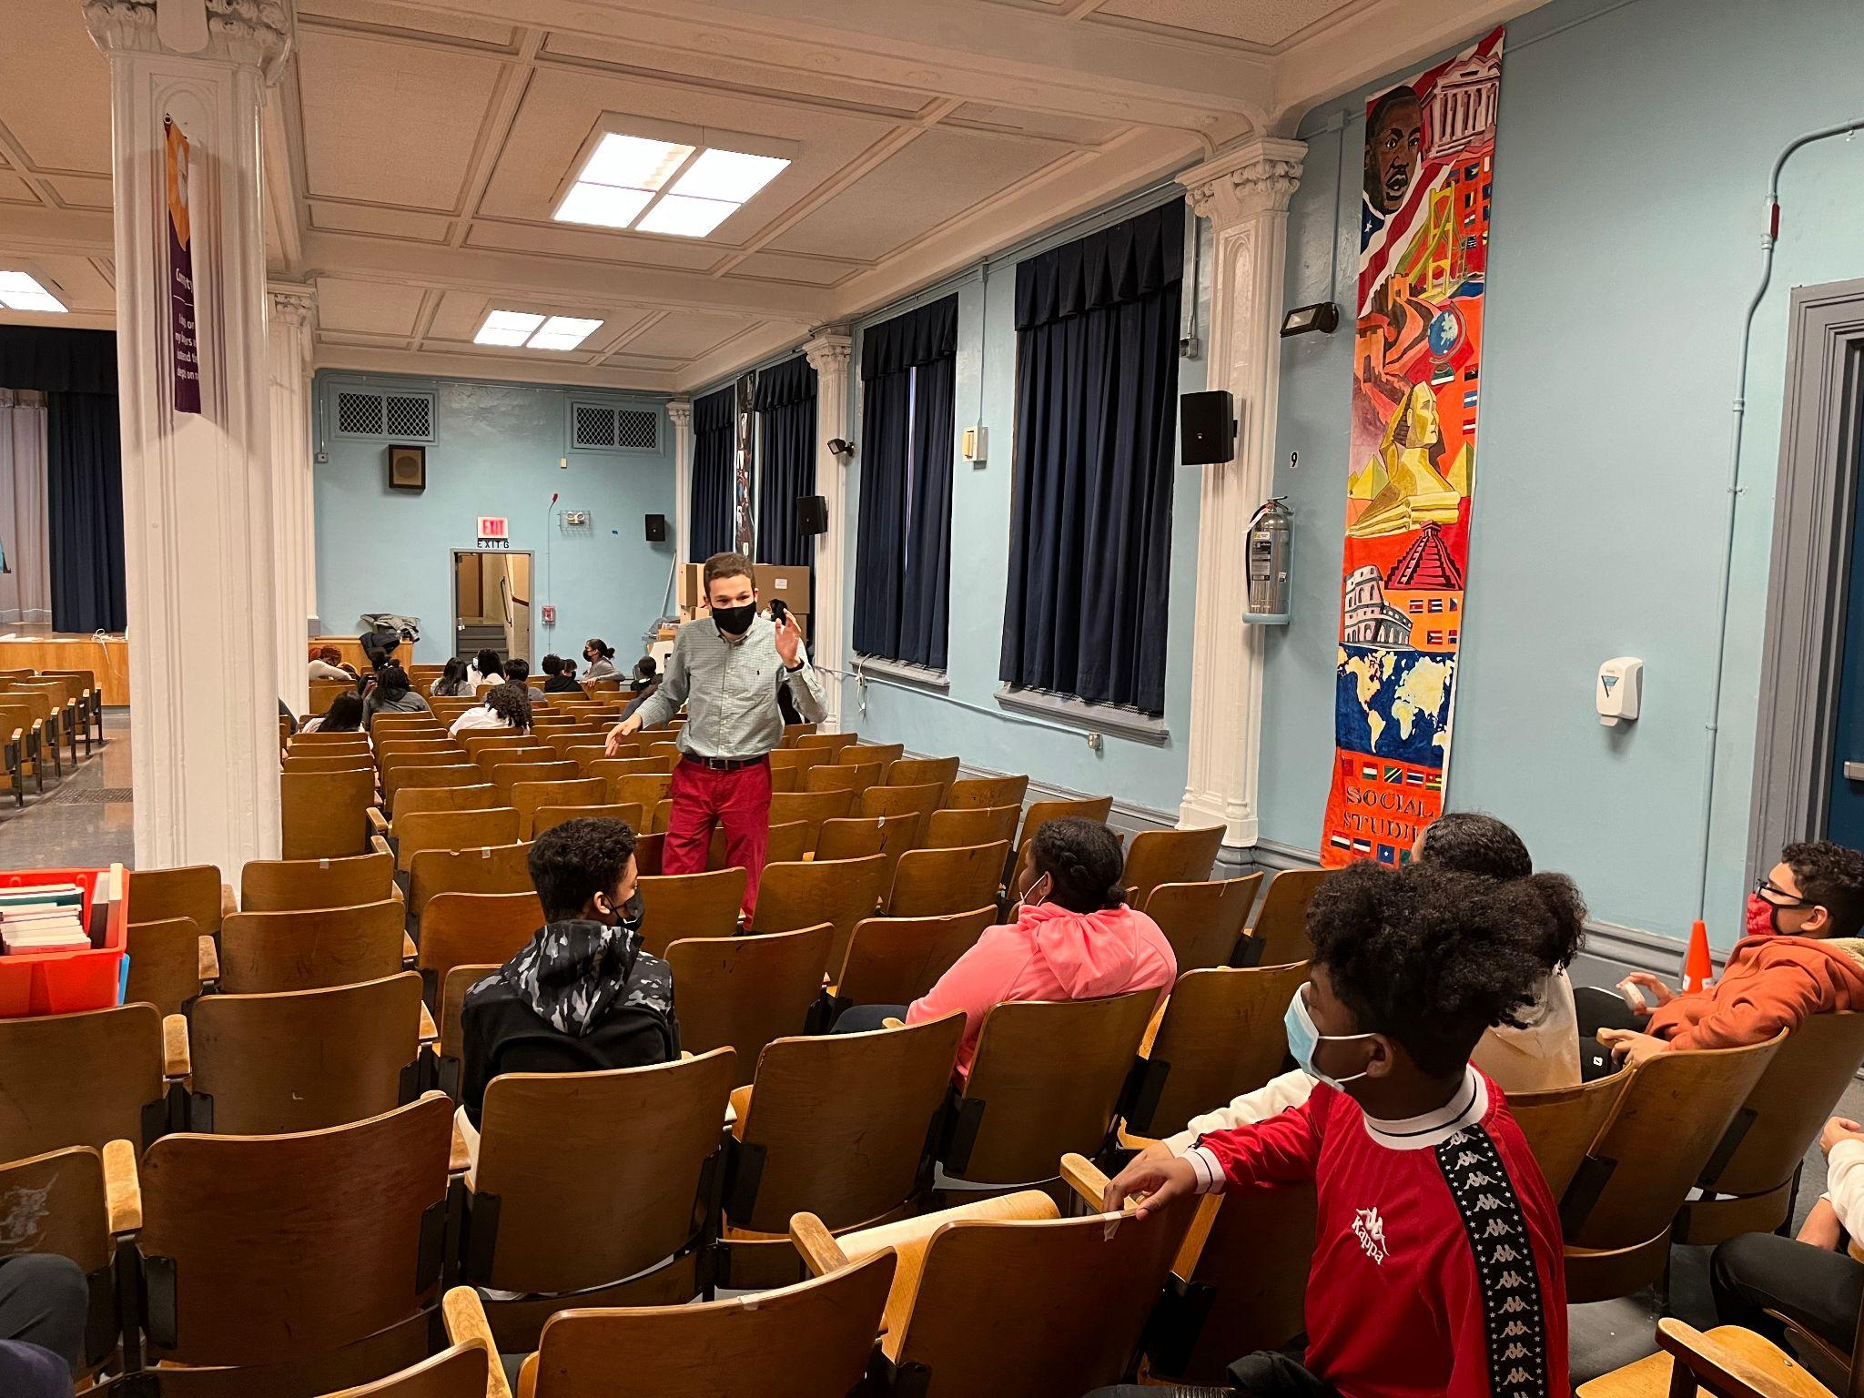
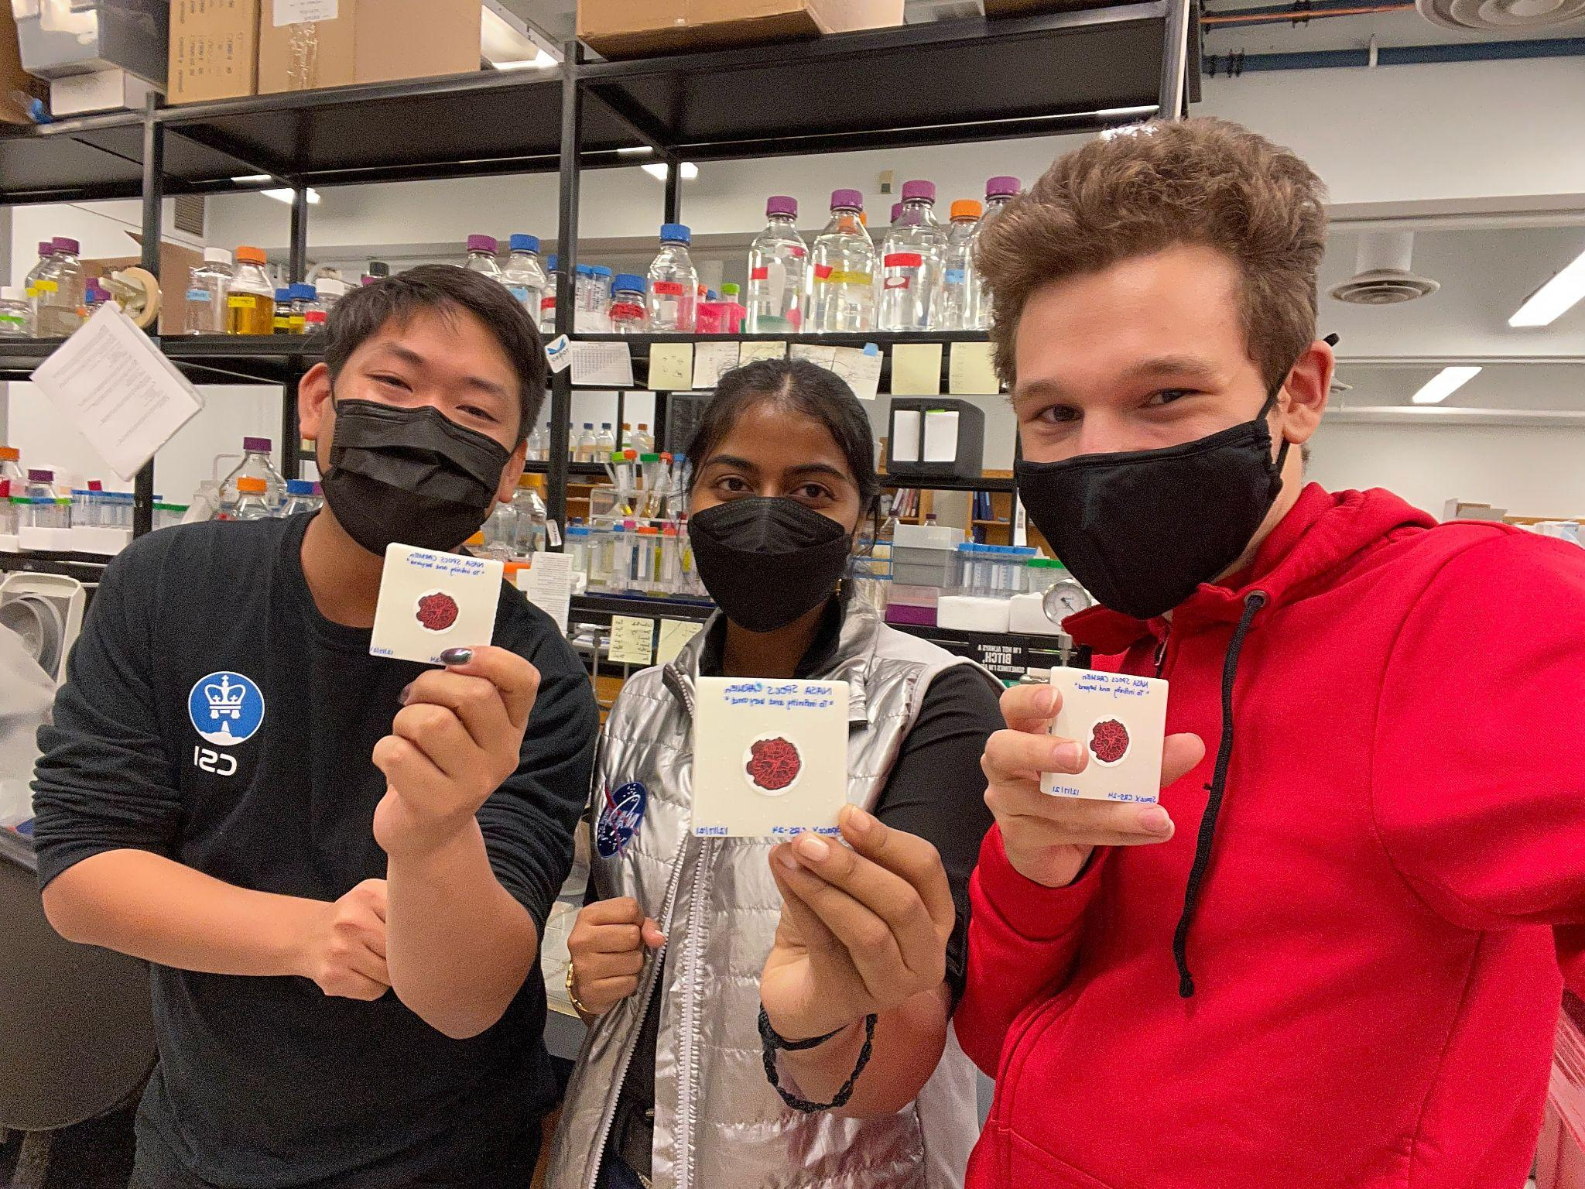
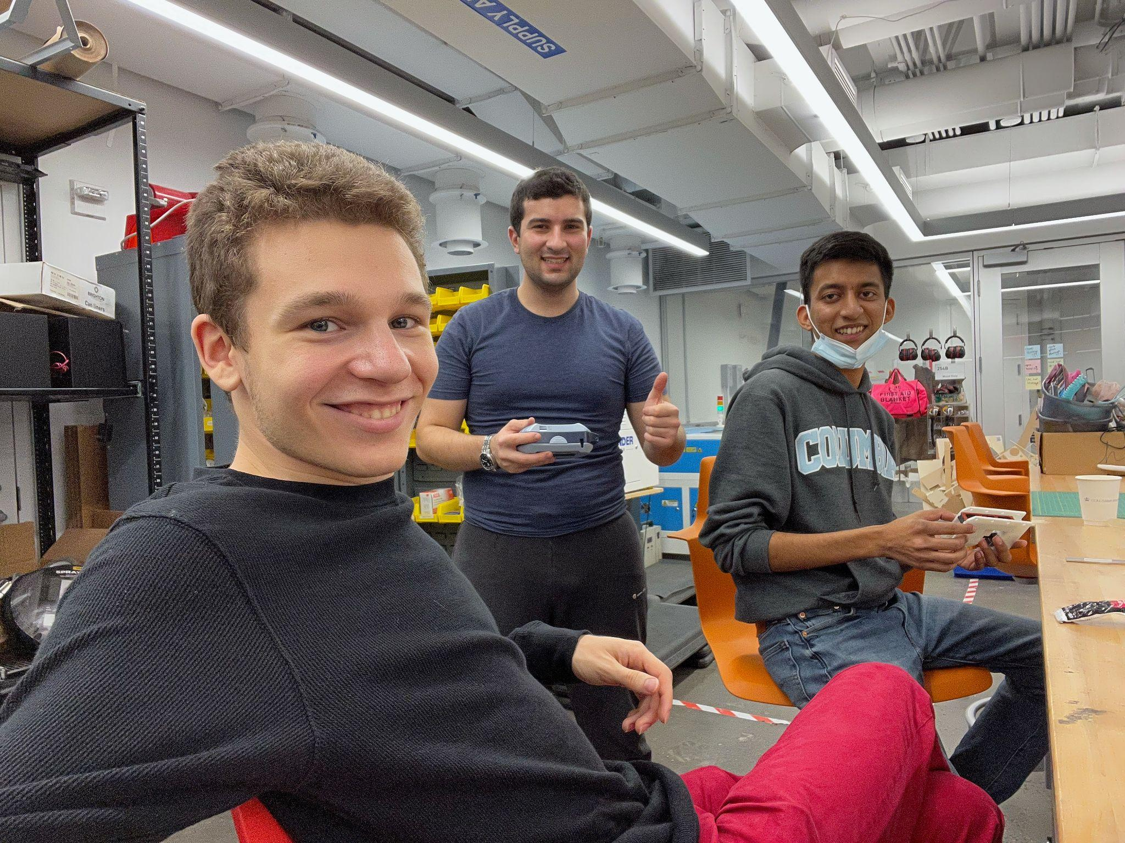
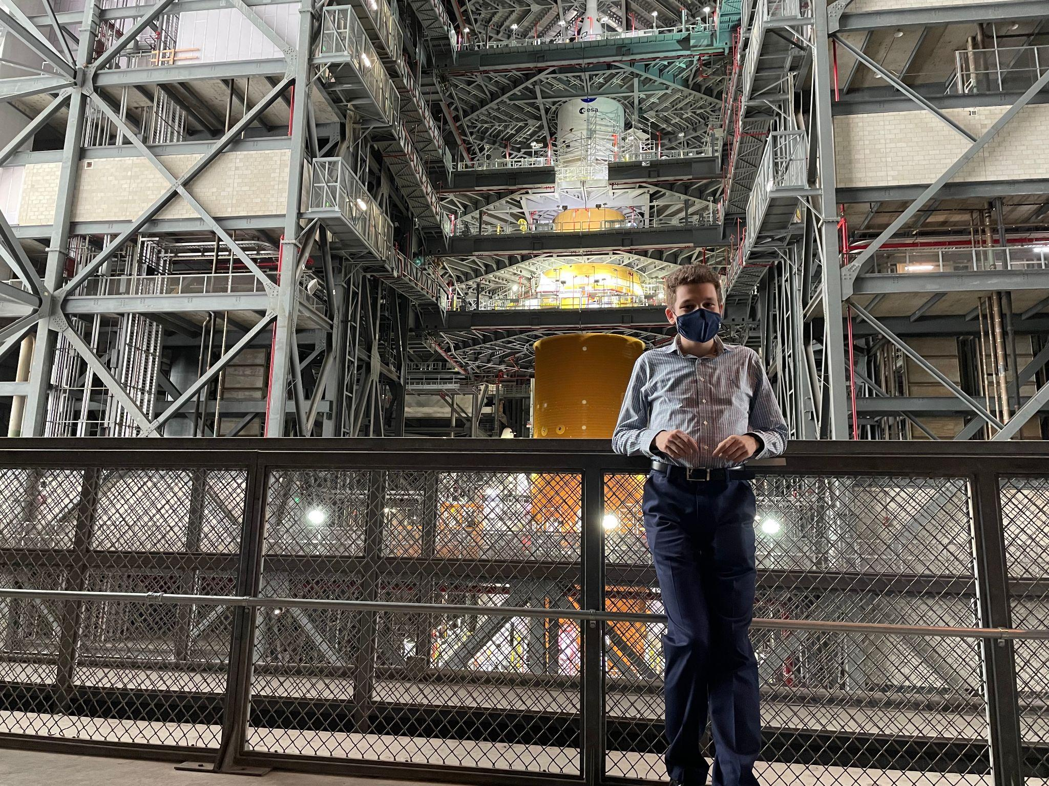
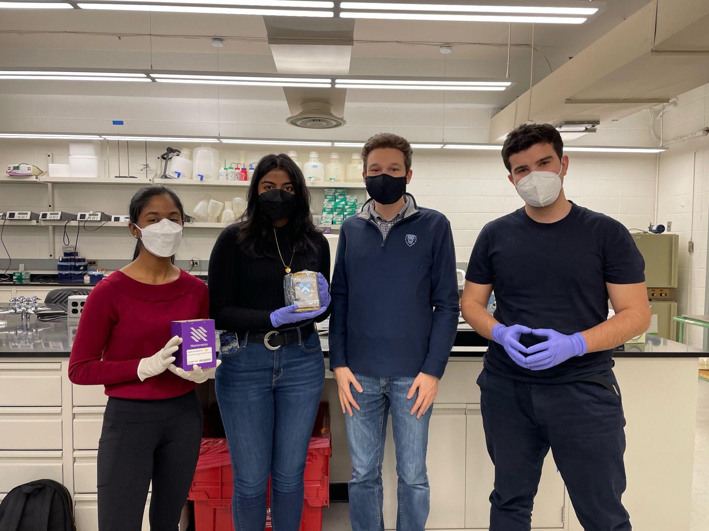
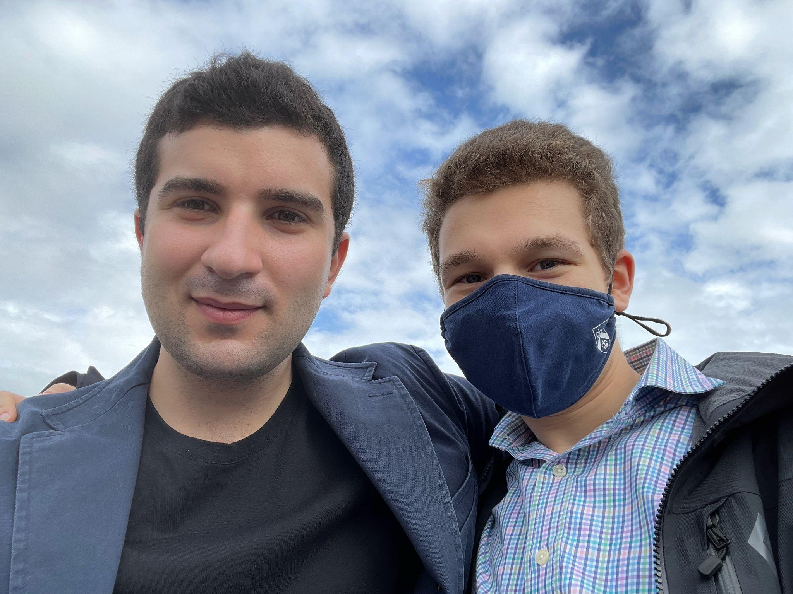
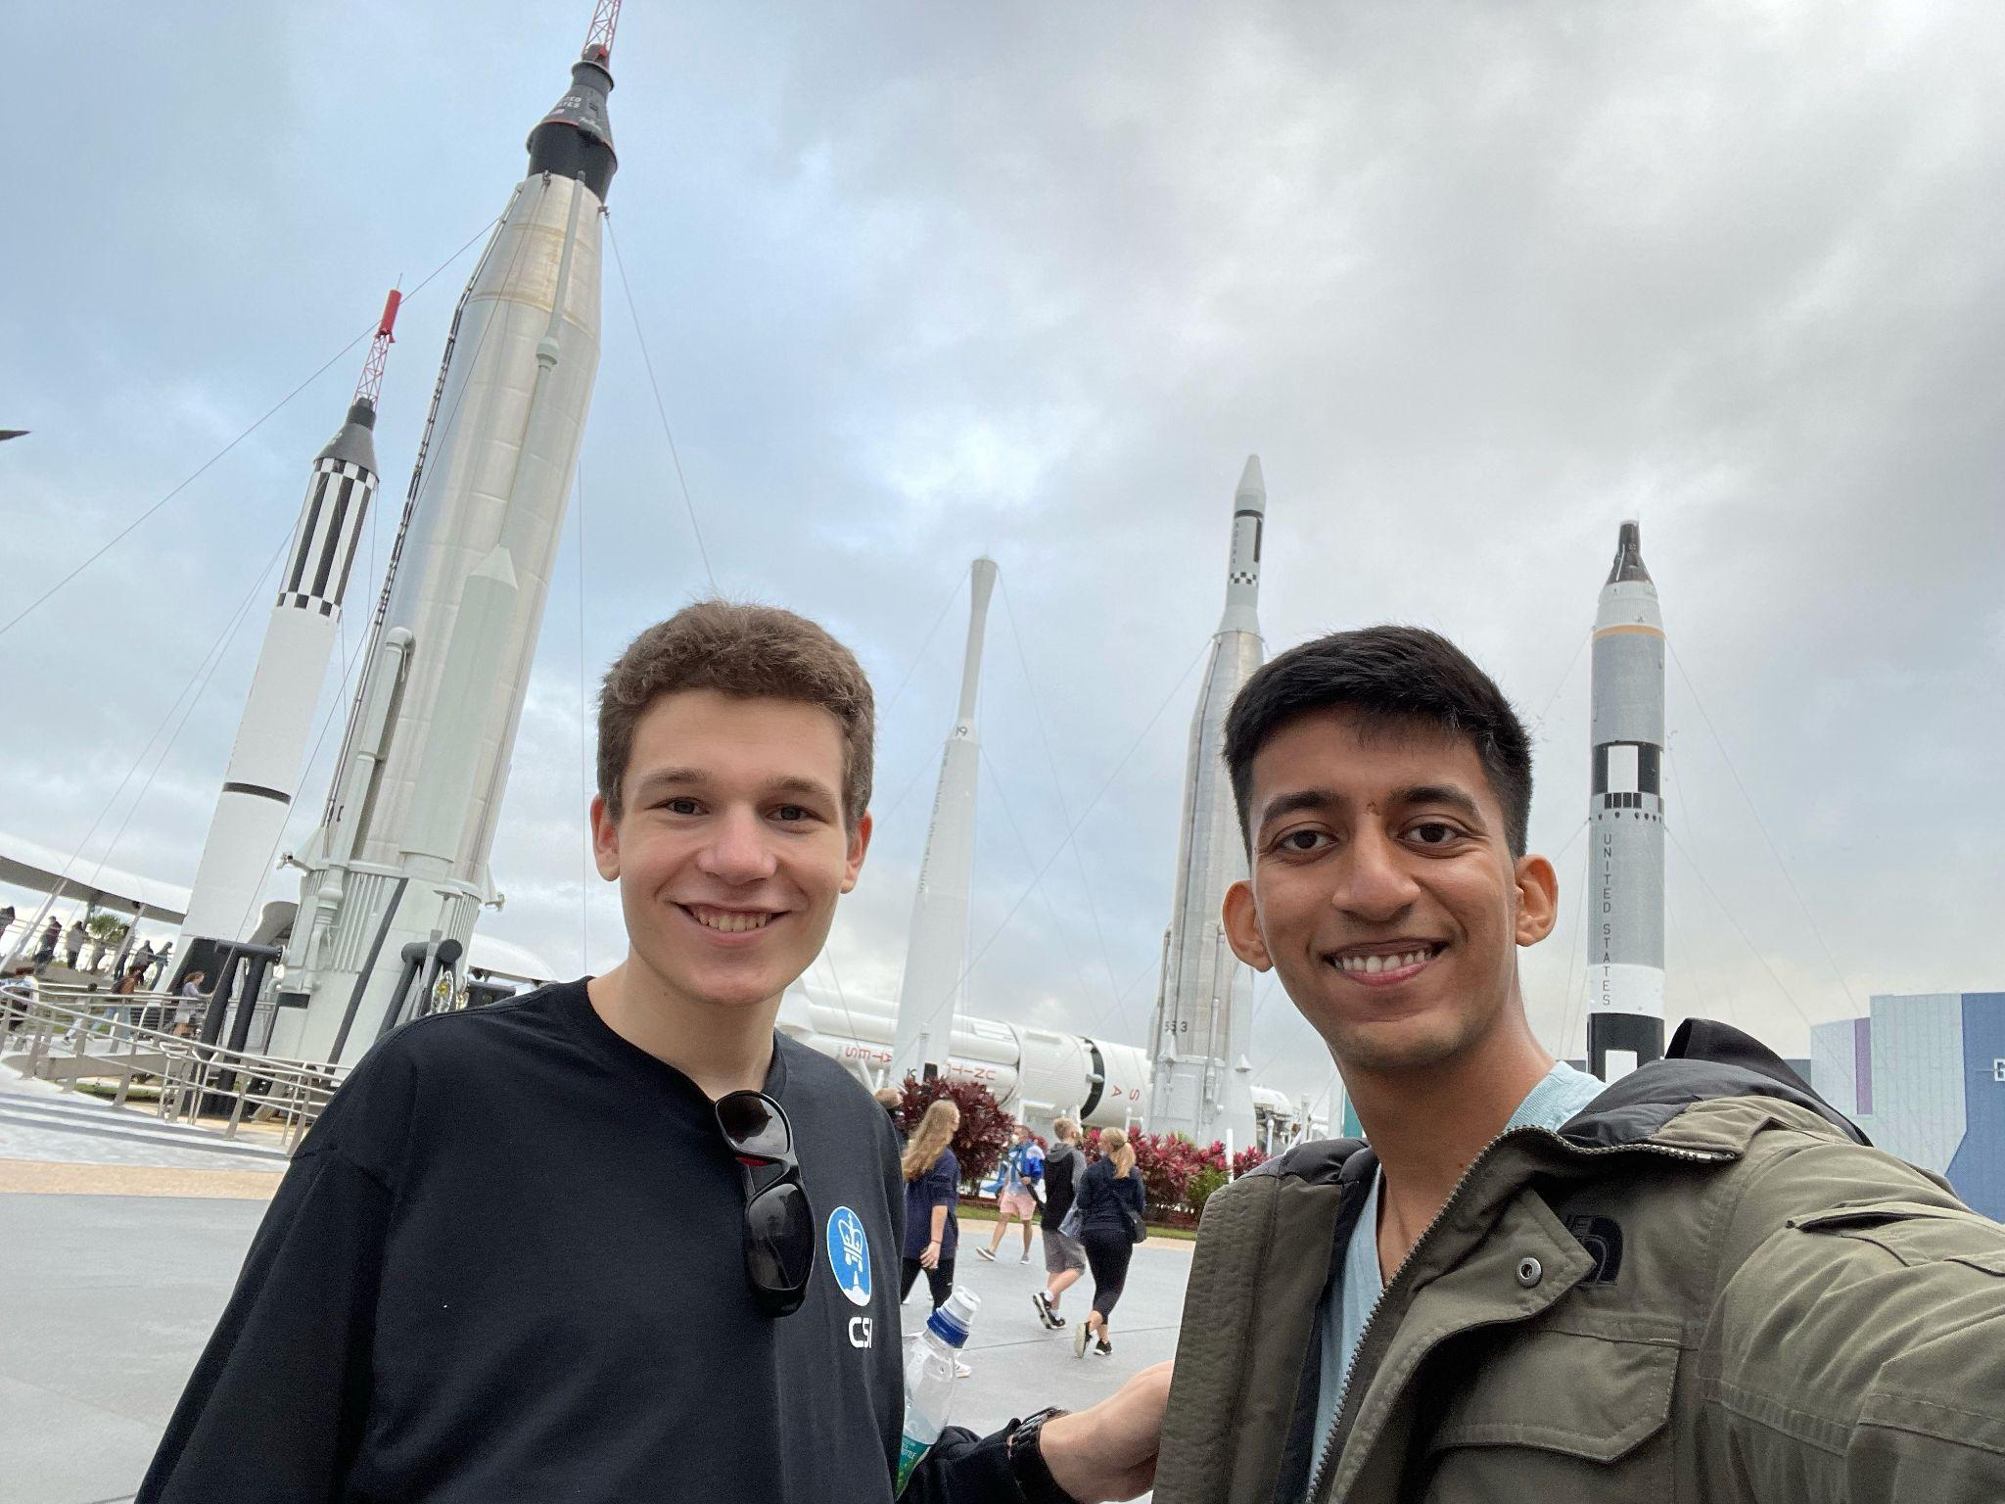
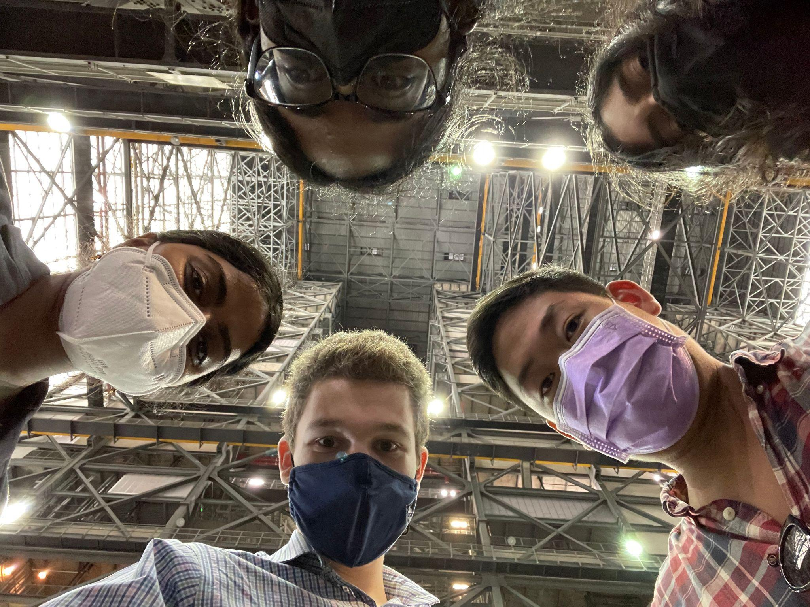
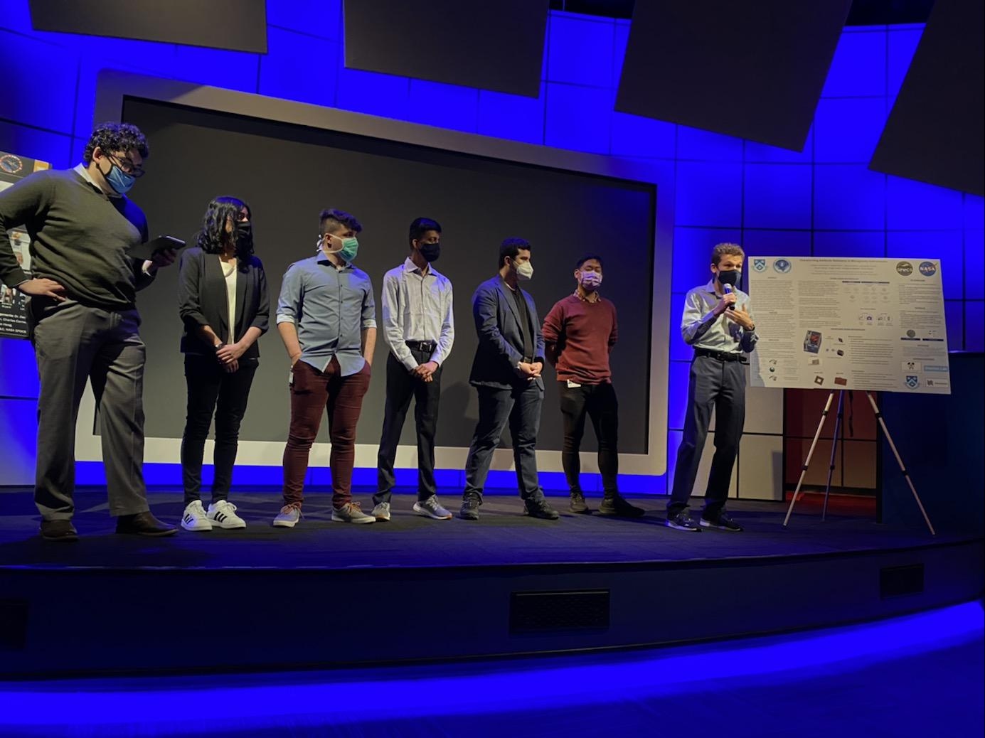
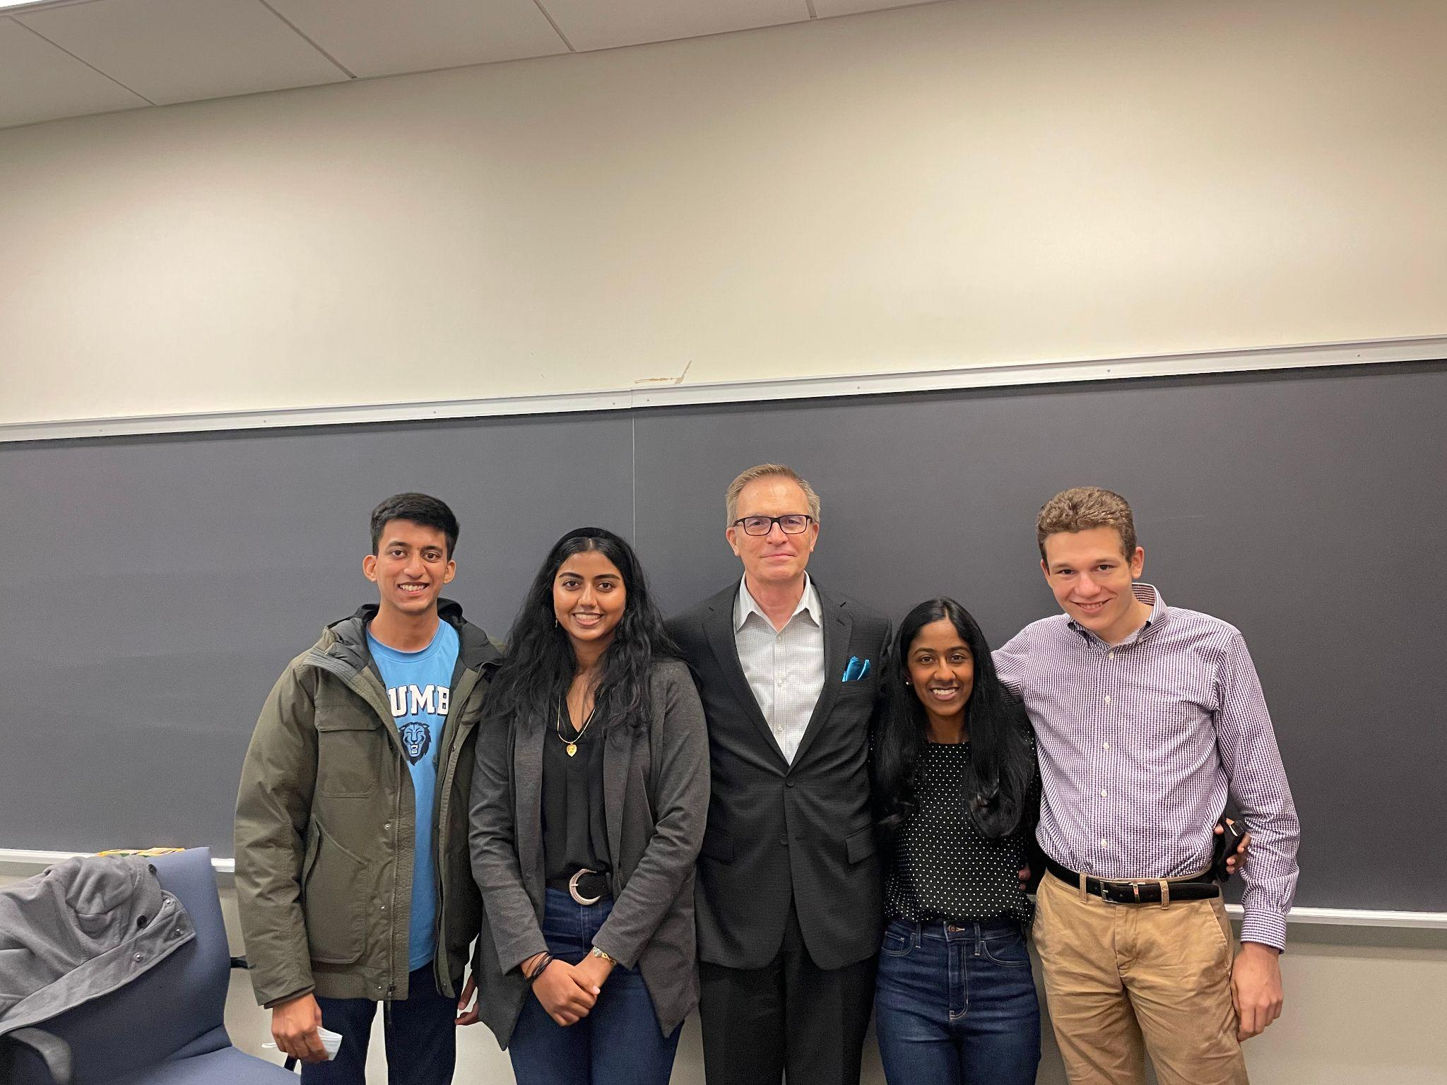
Why?
Perseverance
Resilience
Experience

Slide 20
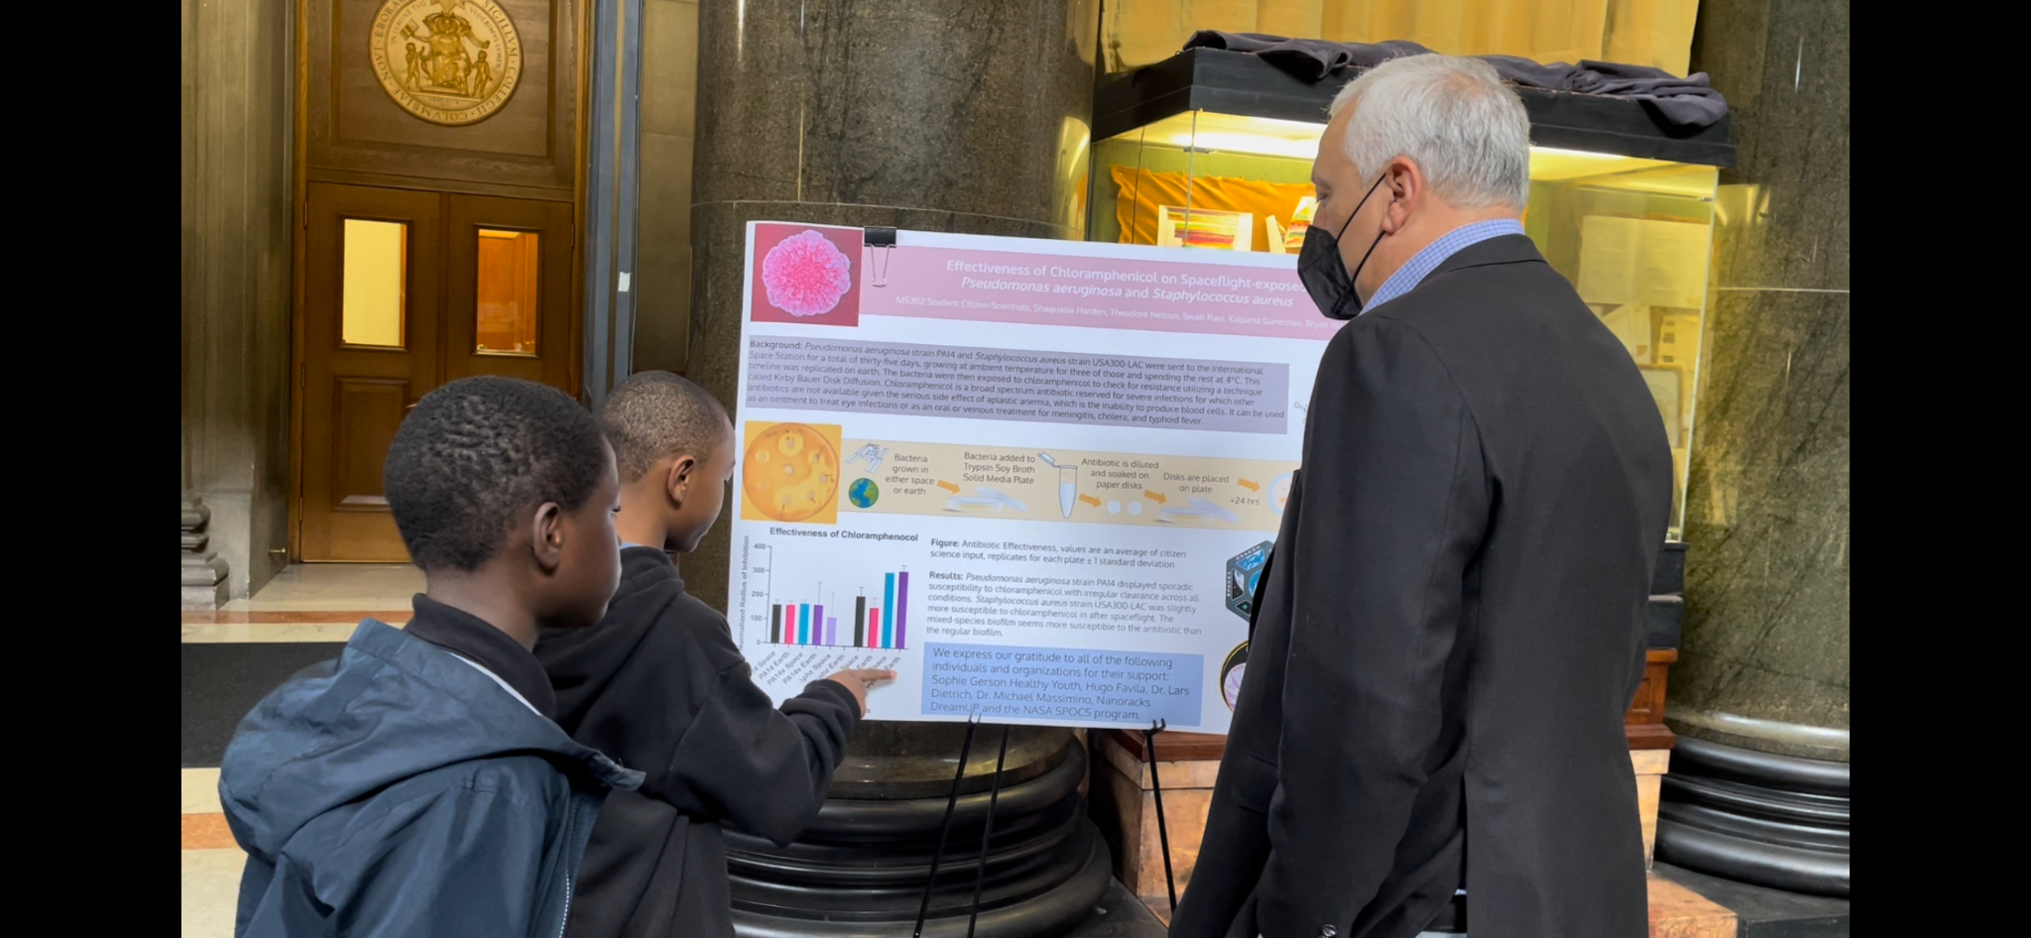
What we do echoes beyond ourselves

Slide 21

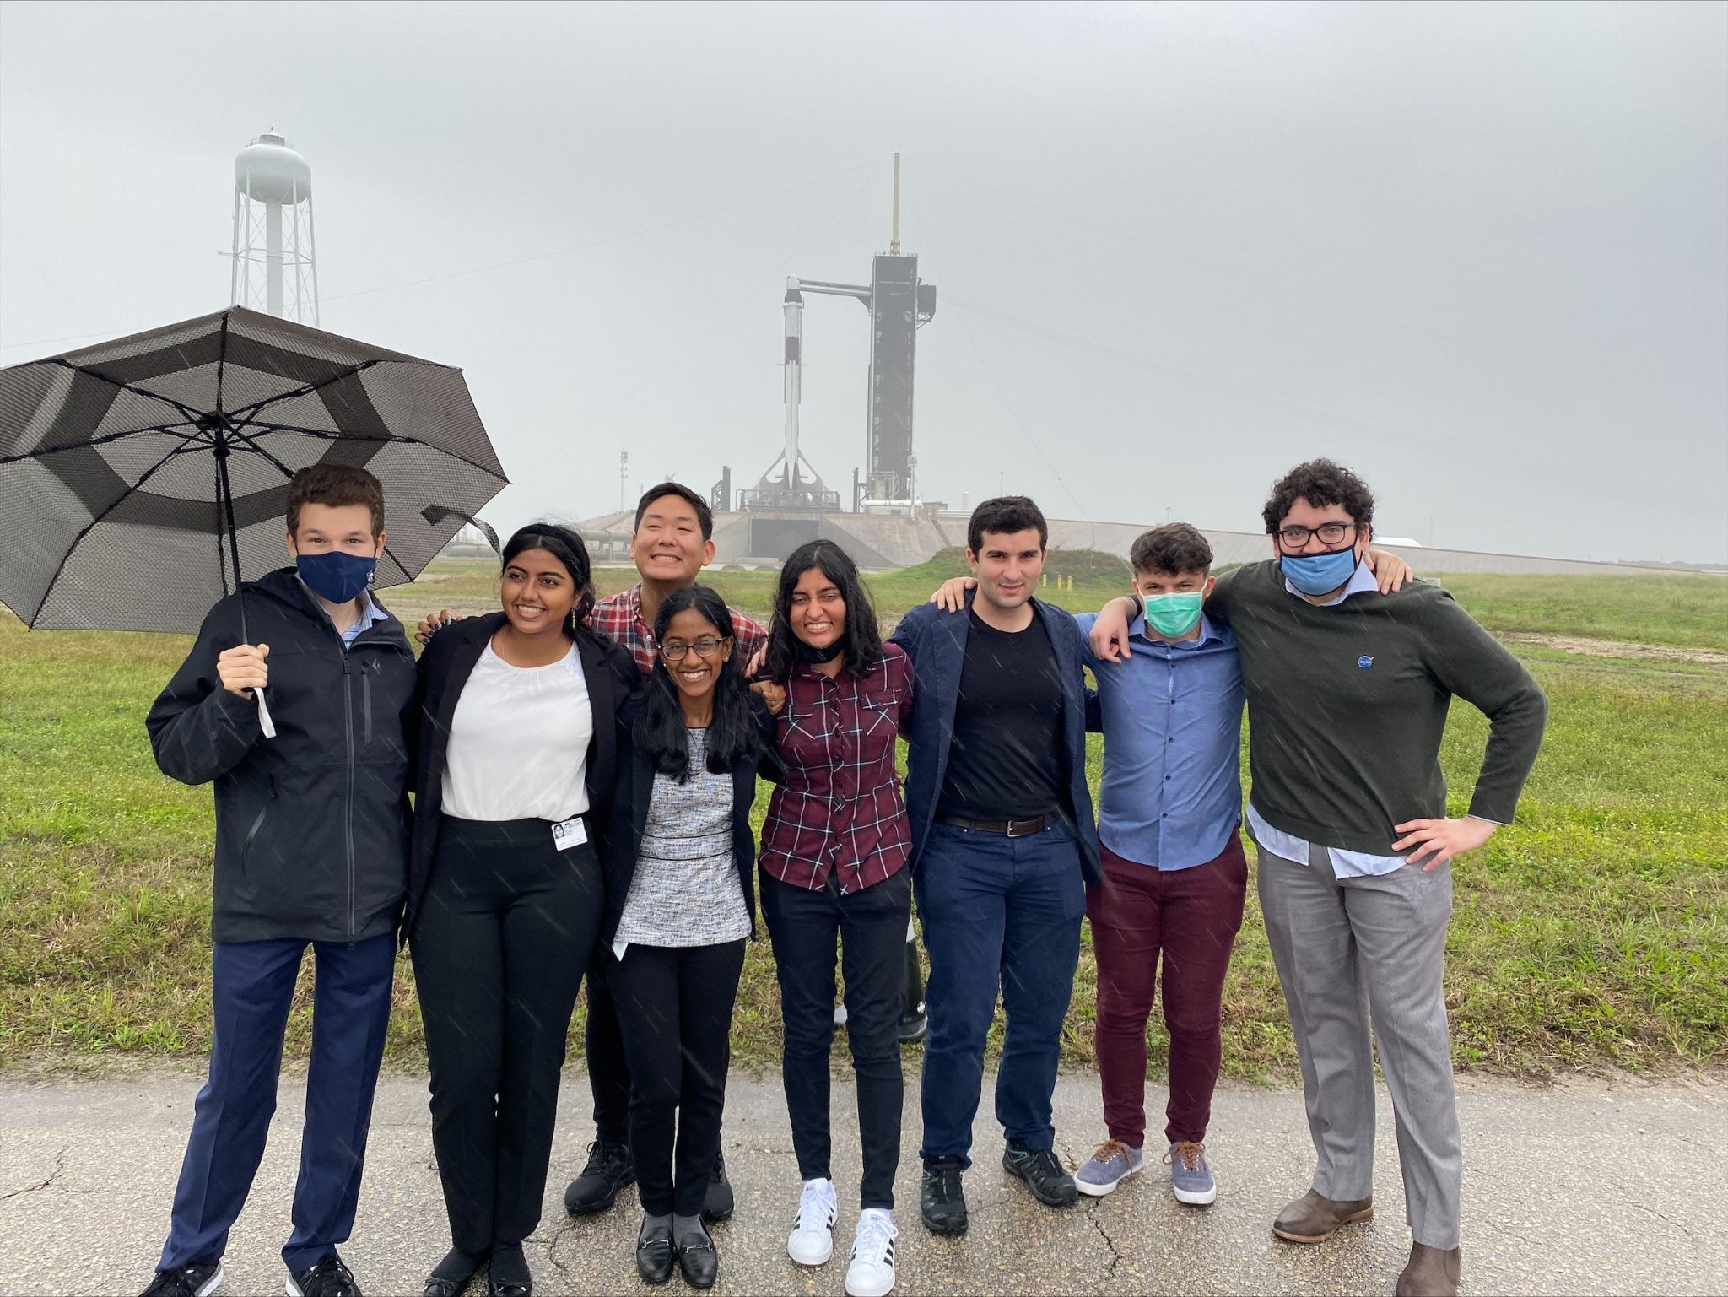
Thank you
CSI SPOCs Members
CSI Outreach Crew
CSI Leadership
Dr. Mike Massimino
Dr. Lars Dietrich
Dr. Rajesh Soni
Dr. Anne-Catrin Uhlemann
The Carleton Laboratory at Columbia University
Dr. Raimondo Betti
Joe Viola
Julia Wolfenbarger
Lauren Milord
Jessica Sain
Krystal Winters
Becky Kamas

Slide 22
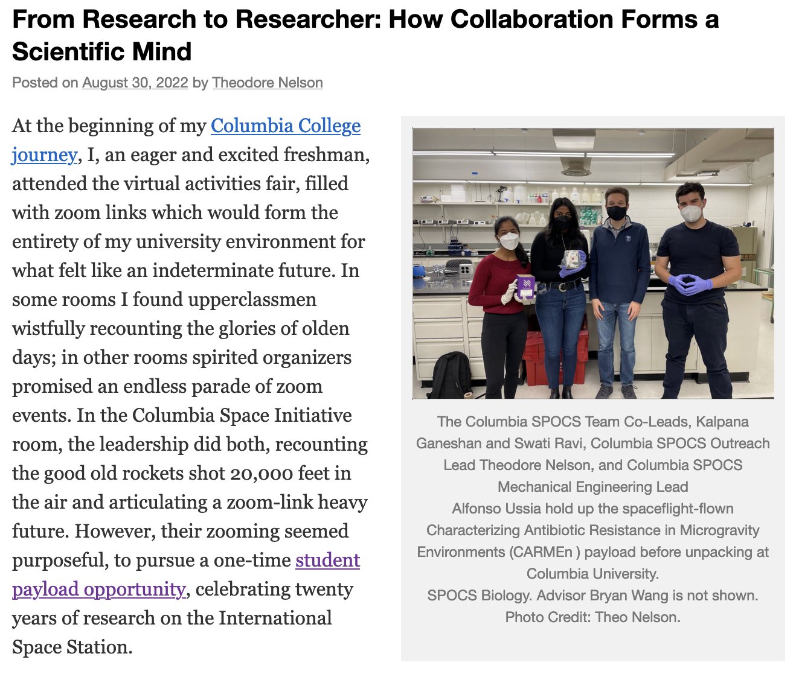

Learn
more

Slide 23


